Slide 1
CS111: Operating Systems Principles
Lab 1B: Simpleton Shell
Vishwas Suryanarayanan

Slide 2
Problem 1B: Make your own shell
Full Description here: https://web.cs.ucla.edu/classes/winter19/cs111/assign/lab1.html
Setup:
Development environment with gcc, glibc, make, gdb
Goal:
Make your own shell
Support creation and opening of files, subprocess creation.
Work with child processes and interprocess communication
Exit with appropriate messages on errors
Submit:
Tar ball with source module, Makefile, README

Slide 3
Review of getopt_long(3)
Function definition:
int getopt_long(int argc, char * const argv[], const char *optstring, const struct option *longopts, int *longindex);
struct option
struct option { const char *name;
int has_arg;
int *flag;
int val;
};
optstring:
Contains a series of characters that correspond to the short options
A colon is placed after a character to indicate that the option that precedes the colon has a argument value passed

Slide 4
Review of pipe (3)
Function definition in signal.h:
int pipe(int fd[2]);
Used to create a pipe:
A file with no name, and 2 file descriptors: a read-end and a write end
fd[0] : read end
fd[1] : write end
Used for interprocess communication between processes that share some level of parent-child relationship
Used even in bash: echo “Hello world” | grep “Hello”

Slide 5
Review: fork (2)
Used to create a child process
pid_t fork(void);
Returns two values on success! How?
Returns 0 to the child process
Returns a number > 0 to the parent process
PID of the child process
Used in UNIX systems for the creation of any process
Parent can monitor the child process’ resource usage, exit status, etc.

Slide 6
Review: What does the child get?
The open file descriptors
A copy of the code and data segments
A copy of the stack
Resource utilization is set to 0
The parent’s signal mask
But not!
The process id, parent process id
Memory locks, alarms, timers, semaphores, file locks
Pending signals

Slide 7
Review: exec (3) family of commands
Function definitions:
int execl(const char *path, const char *arg, ...); int execlp(const char *file, const char *arg, ...); int execle(const char *path, const char *arg, ..., char * const envp[]); int execv(const char *path, char *const argv[]); int execvp(const char *file, char *const argv[]); int execvpe(const char *file, char *const argv[], char *const envp[]);
But actual system call:
int execve(const char *filename, char *const argv[], char *const envp[]);

Slide 8
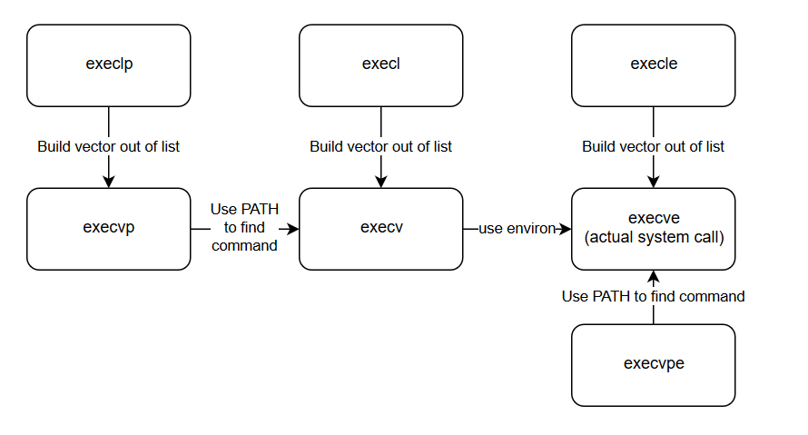
Review: Illustration

Slide 9
Review: wait (2)
Used by a parent process to wait on a child process’ execution
pid_t wait(int *status);
Blocking function calls
Returns the PID of the child process that terminated (OR ?)
Status: a pointer to an integer, wherein a status word will be written
Can be inspected with these macros:
WIFEXITED(status)
WEXITSTATUS(status)
WIFSIGNALLED(status)
WTERMSIG(status)
WIFSTOPPED(status)

Slide 10
waitpid (2)
Function:
pid_t waitpid(pid_t pid, int *stat_loc, int options)
Arguments:
pid: which child to wait for
-1: All children
>0: The child with pid = pid
0: any child with same pgid (process group id)
-x: any child with pgid = x
status word: same as wait
Options:
WNOHANG
WCONTINUED

Slide 11
Review: signal
Function definition in signal.h:
void (*signal(int sig, void (*func)(int)))(int);
Used to register a signal handler function,
pointed to by the second argument of the function signature
handles the signal with signal code sig
The signal-handler is called when the signal is encountered during execution
Ignoring a signal: SIG_IGN
Default handler: SIG_DFL
Can’t ignore or catch: SIGKILL, SIGSTOP

Slide 12
Handling termination of child in the parent
waitpid can be used to know if the child terminated due to a signal, or gracefully.
Macros to help with this:
WIFEXITED
WEXITSTATUS
WIFSIGNALED
WTERMSIG
WCOREDUMP
WIFSTOPPED
WSTOPSIG

Slide 13
The example in the problem description
File | File Descriptor
a | 0
Read-end of pipe 1 | 1
Write-end of pipe 1 | 2
Read-end of pipe 2 | 3
Write-end of pipe 2 | 4
c | 5
d | 6
simpsh \
--rdonly a \
--pipe \
--pipe \
--creat --trunc --wronly c \
--creat --append --wronly d \
--command 3 5 6 tr A-Z a-z \
--command 0 2 6 sort \
--command 1 4 6 cat b - \
--close 2 \
--close 4 \
--wait

Slide 14
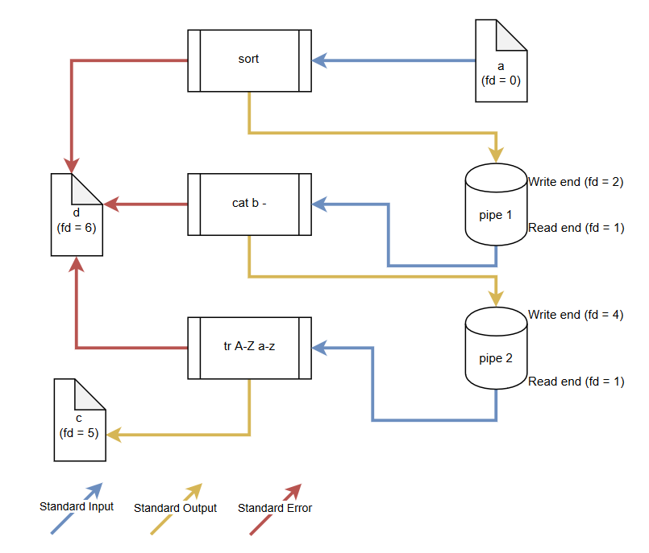
The flow of data
simpsh \
--rdonly a \
--pipe \
--pipe \
--creat --trunc --wronly c \
--creat --append --wronly d \
--command 3 5 6 tr A-Z a-z \
--command 0 2 6 sort \
--command 1 4 6 cat b - \
--close 2 \
--close 4 \
--wait
Remember:
(sort < a | cat b - | tr A-Z a-z > c) 2>> d

Slide 15
Remember!
We have a sanity test script to use again
Tar-ball must contain:
README with NAME, ID, EMAIL
Source module, and any test scripts (for make check)
Makefile
While building, don’t forget these flags: g Wall Wextra
Make sure all erroneous input are handled as per the spec

